Slide 1
Object Oriented Programming
Lecture 9 - Stack

Slide 2
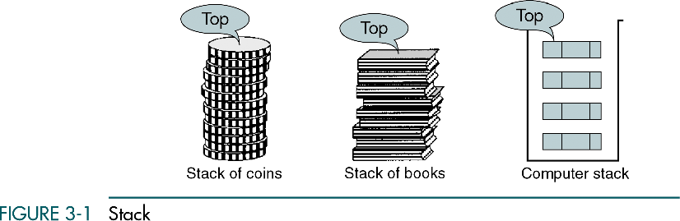
Stack

Slide 3
Stack
A stack is a data structure that stores data in such a way that the last piece of data stored, is the first one retrieved
also called last-in, first-out
Only access to the stack is the top element
consider trays in a cafeteria
to get the bottom tray out, you must first remove all of the elements above

Slide 4
Stack
Push
the operation to place a new item at the top of the stack
Pop
the operation to remove the next item from the top of the stack

Slide 5
3.1 Basic Stack Operations
The stack concept is introduced and three basic stack operations are discussed.
3.2 Stack Linked List Implementation
In this section we present a linked-list design for a stack. After developing the data structures, we write pseudocode algorithms for the stack ADT.
3.3 C Language Implementations
This section presents a simple non-ADT implementation of a stack. We develop a simple program that inserts random characters into the stack and then prints them.
3.4 Stack ADT
We begin the discussion of the stack ADT with a discussion of the stack structure and its application interface. We then develop the required functions.
3.5 Stack Applications
Three basic application problems-parsing, postponement, and backtracking-are discussed and sample programs developed. In addition, several other stack applications are presented, including the classic Eight Queens problem.
3.6 How Recursion Works
This section discusses the concept of the stack frame and the use of stacks in writing recursive software
Basic Stack Operations
Push
Pop
Stack Top

Slide 6
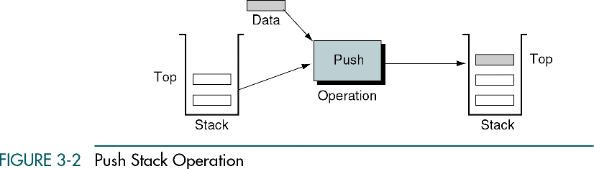

Slide 7
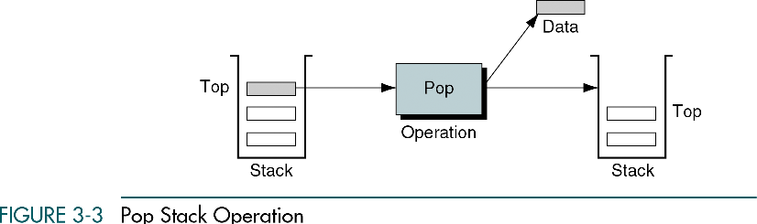

Slide 8
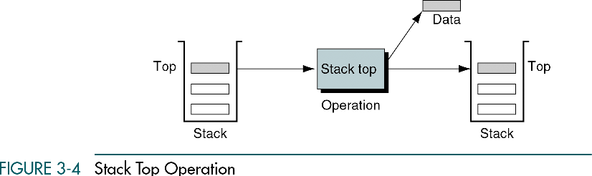

Slide 9
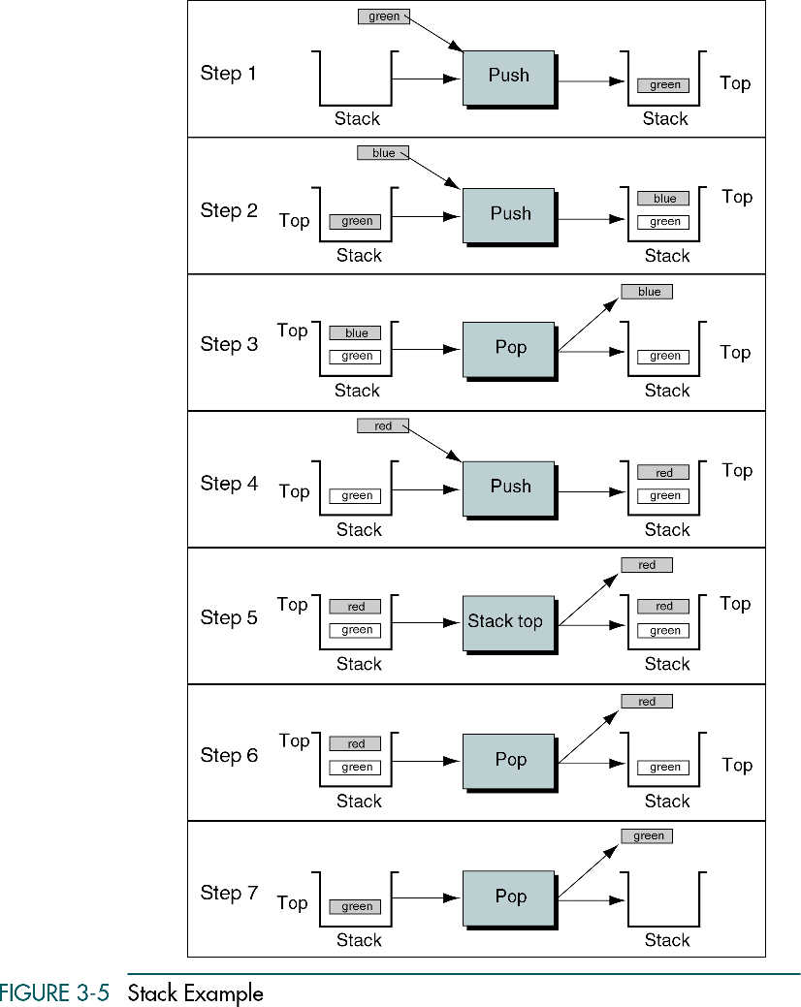

Slide 10
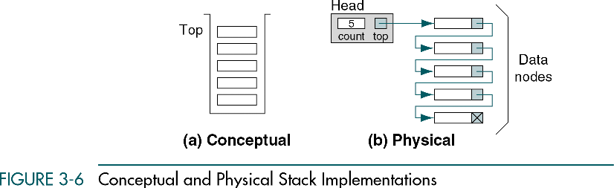
Stack Linked List Implementation

Slide 11
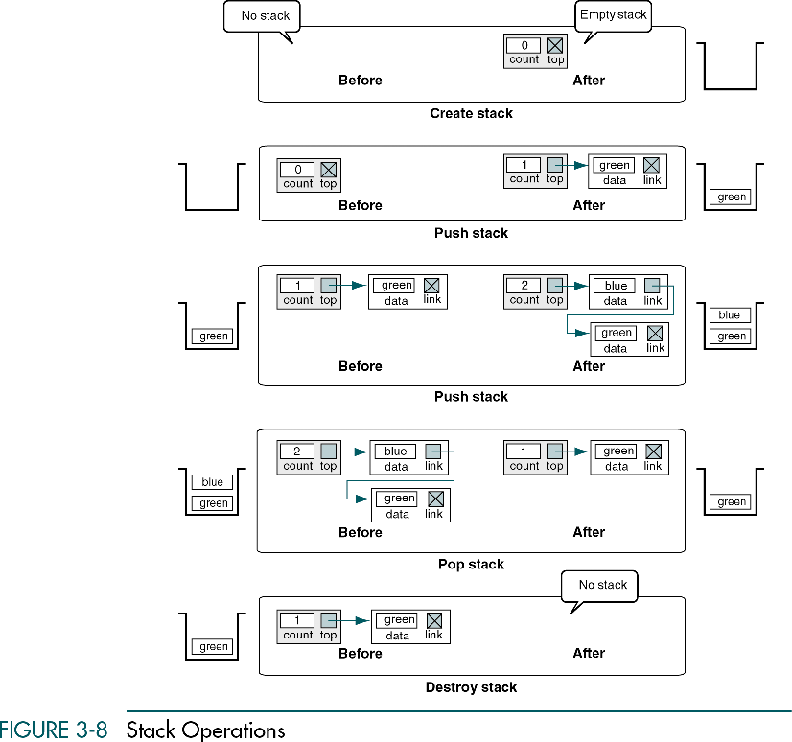

Slide 12
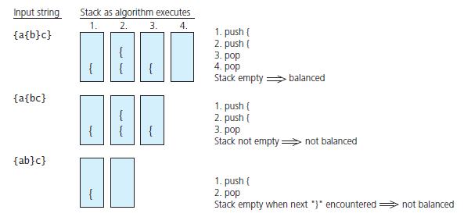
Simple Uses of a Stack
FIGURE 6-3 Traces of the algorithm that checks for balanced braces

